Slide 1


CLAUDE CODE MASTERCLASS

Slide 2
INTRODUCTION TO AGENTS

Slide 3

"6 months ago, building an AI agent took 2 days.
Today, AI agents build AI agents in minutes."
© All rights reserved for Dr. Ryan Ahmed @Stemplicity Inc.

Slide 4
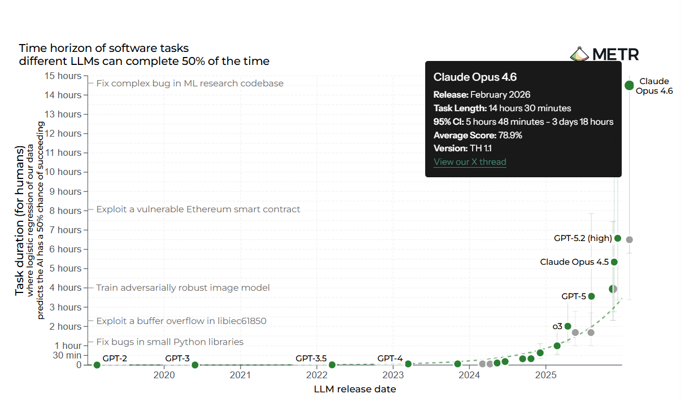
AI Can Now Work a Full Shift
© All rights reserved for Dr. Ryan Ahmed @Stemplicity Inc.
Source: https://metr.org/blog/2025-03-19-measuring-ai-ability-to-complete-long-tasks/

Slide 5
Building Agents is Changing Quickly
We will start by building AI agents using OpenAI Agents SDK to understand the fundamentals and then move to automating Agentic workflow creation with Claude Code.
2024
2025
2026
Manual Era
SDK Era
Autonomous Era
© All rights reserved for Dr. Ryan Ahmed @Stemplicity Inc.
Weeks
per agent
Hours
per agent
Minutes
per agent
→
→
Hand-coded
tool integrations
OpenAI Agents SDK
CrewAI
Claude Code
AI teams building agents
LangChain/LangGraph
N8N, custom scripts
Structured tools
& handoffs built in
Fully automated
design → code → test

Slide 6
WHAT IS AN AI AGENT?

Slide 7



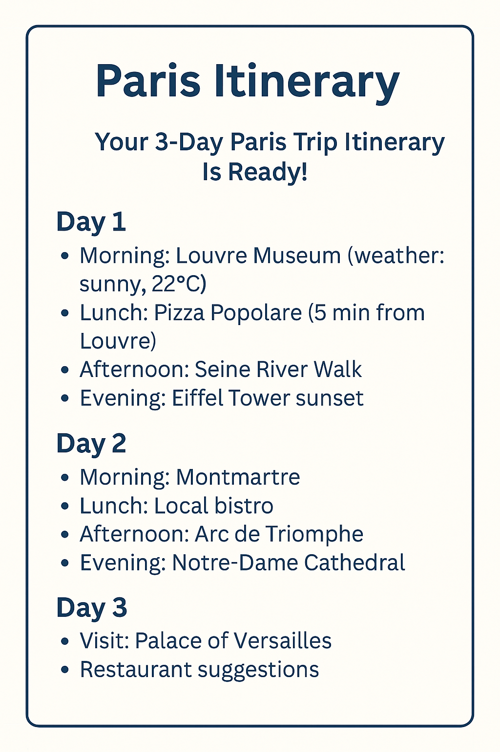






AI Agents 101
AI agents are intelligent systems that take a goal, plan the steps, and autonomously execute them using tools & knowledge with minimal human input.
Planning: schedule sightseeing, check weather
Memory: recalls that user likes museums
Tools: maps, hotel, weather
Guardrails: safe suggestions
Handoff: pass task to restaurant booking agent
AI Agent
Guardrails
“Plan my 3-day trip to Paris”
© All rights reserved for Dr. Ryan Ahmed @Stemplicity Inc.
Large Language Model
Handoffs
Planning
Tools
Memory

Slide 8
AI AGENTS FOUNDATIONS

Slide 9
What is an AI Agent?
An AI agent is a system that uses an LLM as its reasoning engine to autonomously plan, take actions, and adapt based on feedback to accomplish goals.
LLM (Chatbot)
AI Agent
Responds to a single prompt
No access to external tools
No persistent memory
Stateless interaction
Plans multi-step workflows
Uses tools (APIs, search, code)
Maintains context & memory
Autonomous decision-making
© All rights reserved for Dr. Ryan Ahmed @Stemplicity Inc.
An agent = LLM + Tools + Memory + Planning Loop

Slide 10
AI Agents Anatomy
An AI Agent is a system built around an LLM that can autonomously reason, plan, use tools, and learn from feedback to accomplish complex goals.
Planning
Tools
LLM
Reasoning Engine
Memory
© All rights reserved for Dr. Ryan Ahmed @Stemplicity Inc.
Observation
P
Planning
T
Tools
M
Memory
O
Observation
Breaks goals into sub-tasks, decides what to do next. Uses ReAct loops, chain-of-thought, and self-reflection.
Interacts with the world: APIs, code execution, web search, file I/O, databases, and MCP servers.
Short-term (conversation context) and long-term (vector DB, embeddings) to retain and recall information.
Interprets tool results and environment feedback to evaluate progress and decide next actions.

Slide 11

Weather Agent Walkthrough – Part 1
Agent Reasoning
Parse Intent:
User
User wants weather info
Context
You are an assistant that helps users with questions about weather.
Instruction
If the user asks about weather, use the Weather tool. Ask the user for additional details if the request is unclear.
Check Memory:
System Prompt
No city preference stored
Identify Gap:
Need a city to call API
Plan:
Ask user for city first, then call weather API
Instructions
User Prompt
What is the weather today?
Planning/
Reasoning
© All rights reserved for Dr. Ryan Ahmed @Stemplicity Inc.
Agent
LLM
Agent Response:
What is the city?
Storage/
Retrieval
Memory

Slide 12
Weather Agent Walkthrough – Part 2
Memory Updated:
{ user_city: "Toronto" }
Context
You are an assistant that helps users with questions about weather.
Instruction
If the user asks about weather, use the Weather tool. Ask the user for additional details if the request is unclear.
Tool Call:
get_weather("Toronto", "today")
System Prompt
{
"city": "Toronto, ON",
"temp": "-5°C",
"condition": "Light Snow",
}
API Response
Instructions
User Prompt
Toronto
User
Planning/
Reasoning
Agent
LLM
© All rights reserved for Dr. Ryan Ahmed @Stemplicity Inc.
Agent Response:
"Weather for Toronto :
-5°C, light snow, Bundle up!"
Storage/
Retrieval
Call Tool
Tools
Memory

Slide 13
MCP

Slide 14









Model Context Protocol (MCP)?
MCP is an open standard and open-source framework introduced by Anthropic to standardize how AI models interact with external tools, systems, and data sources.
Problem (Without MCP)
Solution (With MCP)
© All rights reserved for Dr. Ryan Ahmed @Stemplicity Inc.
MCP
AI Agent
AI Agent
MCP
MCP
Custom APIs
Standardized APIs

Slide 15
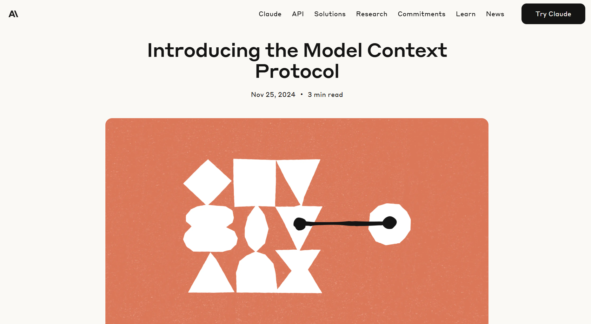
MCP by Anthropic Documentation
https://www.anthropic.com/news/model-context-protocol
© All rights reserved for Dr. Ryan Ahmed @Stemplicity Inc.

Slide 16

Real-world MCP Application
Assume we have a simple AI agent that utilizes a currency conversion tool.
The agent will use Model Context Protocol (MCP), which is a standardized protocol that connects LLMs and AI agents to various external tools and data sources.
MCP server
What is $1000 USD in CAD?
Currency Convertor Tool
© All rights reserved for Dr. Ryan Ahmed @Stemplicity Inc.
LLM
MCP
Client
C$1,370
MCP is an open protocol designed to be a standard way for models to discover & interact with tools. It’s like a universal plug adapter for AI tools!

Slide 17
AGENTIC FRAMEWORKS

Slide 18
Agentic Frameworks
Open-source and vendor frameworks for building agents programmatically.
LangGraph
Py / JS
CrewAI
Python
AutoGen (AG2)
Python
Graph-based workflows, cycles, persistence, human-in-the-loop
Role-based multi-agent crews, task delegation, sequential & parallel flows
Microsoft — multi-agent conversations, group chat, code execution
OpenAI Agents SDK
Python
Claude Agent SDK
Py / TS
Google ADK
Python
Native tool use, handoffs between agents, guardrails, tracing
Anthropic — tool use, MCP support, extended thinking, multi-turn
Google — multi-agent, A2A protocol, Vertex AI integration
© All rights reserved for Dr. Ryan Ahmed @Stemplicity Inc.
Semantic Kernel
Multi
Haystack
Python
Smolagents
Python
Microsoft — enterprise AI orchestration, .NET/Java/Python, plugins
Deepset — RAG & NLP pipelines, modular components, document processing
Hugging Face — lightweight, code-first agents, minimal abstractions
LlamaIndex
Py / TS
Agno (Phidata)
Python
Pydantic AI
Python
Data framework — RAG agents, knowledge graphs, multi-step query engine
Model-agnostic, multi-modal, built-in memory & knowledge, fast
Type-safe agent building, structured outputs, dependency injection

Slide 19
No-code/Low-Code Agentic Platforms
Visual builders and platforms that let you create agents without writing code.
n8n
Open
Flowise
Open
Langflow
Open
Open-source workflow automation, 400+ integrations, AI agent nodes
Open-source, drag-and-drop LLM flow builder, LangChain-based
Visual IDE for LangChain, supports custom Python components
Dify
Open
Zapier AI
SaaS
Botpress
SaaS
Open-source LLMOps platform, RAG pipeline builder, prompt IDE
AI-powered automation across 6,000+ apps, natural language setup
Conversational AI platform, visual flow builder, multi-channel
© All rights reserved for Dr. Ryan Ahmed @Stemplicity Inc.
Relevance AI
SaaS
Lindy
SaaS
Vertex AI Agent Builder
Ent.
No-code AI workforce, multi-step agent builder, tool integration
Personal AI assistants, trigger-based workflows, 3,000+ integrations
Google Cloud — enterprise agents, grounding, Gemini-powered
Azure Copilot Studio
Ent.
IBM Watsonx
Ent.
Stack AI
Ent.
Microsoft — enterprise copilots, Power Platform integration
Enterprise AI, governance, on-prem/cloud deployment, compliance
Enterprise no-code, SOC 2, HIPAA, custom model deployment

Slide 20
INTRODUCTION TO OPENAI AGENTS SDK

Slide 21


What is the OpenAI Agents SDK?
A lightweight, Python-first open-source framework released by OpenAI in March 2025 for building agentic AI applications with very few abstractions.
© All rights reserved for Dr. Ryan Ahmed @Stemplicity Inc.
Few primitives (building blocks) = quick to learn
Works great out of the box with room to customize
Provider-agnostic: supports OpenAI + 100+ LLMs via LiteLLM
Python 3.10+ required

Slide 22





Core Primitives (Building Blocks)
Agents
Tools
Handoffs
Guardrails
Tracing
Handoffs allow an agent to delegate tasks to another agent.
Core Building block, it’s an LLMs with instructions, tools, handoffs and structured output
Tools let agents take actions, such as fetching data, running code, calling external APIs.
Guardrails enable you to do checks and validations of user input and agent output to ensure safety.
Built-in tracing, collecting record of events during an agent run: LLM generations, tool calls, handoffs, guardrails.
© All rights reserved for Dr. Ryan Ahmed @Stemplicity Inc.

Slide 23
BUILDING AI AGENTS WITH MEMORY

Slide 24
Defining an Agent
name
A descriptive identifier
Python
instructions
System prompt guiding behavior
from agents import Agent
agent = Agent(
name="Assistant",
instructions="""
You are a helpful
teaching assistant.
""",
tools=[search_web],
handoffs=[expert_agent],
)
tools
Functions the agent can call
handoffs
Other agents to delegate to
© All rights reserved for Dr. Ryan Ahmed @Stemplicity Inc.
guardrails
Validation checks on I/O
output_type
Optional structured output schema

Slide 25
Running the Agent
Python
from agents import Agent, Runner
from agents import Agent, Runner
agent = Agent(
name="Assistant",
instructions="You are a helpful
teaching assistant.",
)
result = await Runner.run(
agent,
"What is an LLM?",
)
print(result.final_output)
Import the Agent class and the Runner that executes it
agent = Agent(...)
Create the same teaching assistant agent
await Runner.run(agent, ...)
Run the agent loop: sends the message to the LLM, handles tool calls, and returns when done
© All rights reserved for Dr. Ryan Ahmed @Stemplicity Inc.
result.final_output
The agent's final text response after the loop completes
Sample Output
An LLM (Large Language Model) is a type of AI trained on massive text datasets to understand and generate human language. Examples include GPT-4, Claude, and Gemini.

Slide 26
Let’s get started!
1
Install
pip install openai-agents
Python 3.10+ required
2
Set API Key
export OPENAI_API_KEY=sk-...
Or use any provider via LiteLLM
© All rights reserved for Dr. Ryan Ahmed @Stemplicity Inc.
3
Create Agent
agent = Agent(name="Bot", ...)
Configure instructions and tools
4
Run!
Runner.run_sync(agent, msg)
Get results with the Runner

Slide 27
PROJECT OVERVIEW

Slide 28
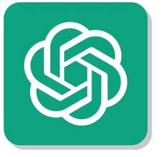

Project 1. Build a Personal Finance AI Agent with Memory
In this project, we’ll build a personal finance AI agent with memory.
Got it! I recorded these expenses.
Updated totals: $220
By category:
groceries $120
transport $40
eating out $60
AI Agent
Q1 = "I spent $120 on groceries, $40 on Uber, and $60 on restaurants this week"
LLM
You’re currently at $220 this week; $30 below your $250 weekly budget. Focus on groceries and eating out to free up more savings.
Suggestions: Save $15–$30: plan 3–4 meals, make a tight shopping list, buy store brands or items on sale, and avoid impulse buys.
© All rights reserved for Dr. Ryan Ahmed @Stemplicity Inc.
Q2 = “My weekly budget is $250. Based on everything I told you so far, where can I cut spending next week?”
Memory Using SQLiteSession( )

Slide 29

Key Learning Outcomes
Design and build a personal finance AI agent with memory that can recall user preferences, past tasks, and ongoing conversations to deliver more personalized, intelligent behavior.
Integrate SQLite-based session storage to enable persistent memory for agents
Use the OpenAI Agent SDK to define agent instructions, run the agent, and manage session state.
Test and compare agent behavior before and after adding memory to evaluate improvements in context retention.
© All rights reserved for Dr. Ryan Ahmed @Stemplicity Inc.

Slide 30

Project 1: Build AI Agents with Memory
Access Jupyter Notebook on Google Colab here: https://drive.google.com/file/d/1N9OP52lXPketAz86vCLL7pybrJdTkI5j/view?usp=sharing
© All rights reserved for Dr. Ryan Ahmed @Stemplicity Inc.

Slide 31
BUILDING AI AGENTS WITH MEMORY USING CLAUDE CODE

Slide 32
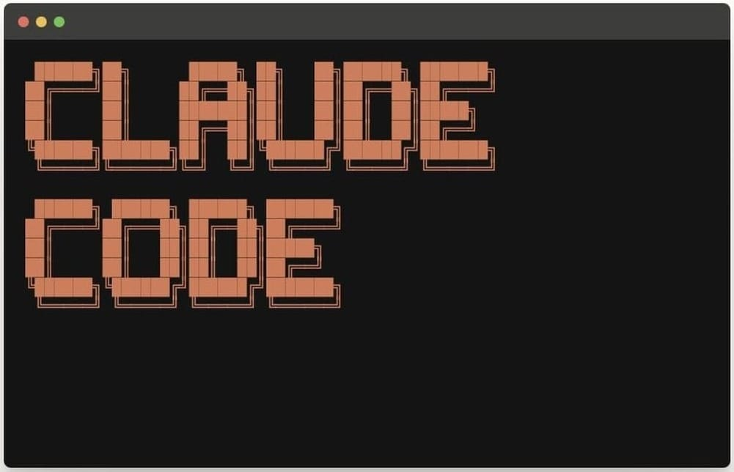
What You’ll Build
1
2
3
© All rights reserved for Dr. Ryan Ahmed @Stemplicity Inc.
Setup
Create venv, install packages, .env file
Agent (no mem)
Build agent, see it forget context
Add Memory
One-line fix with SQLiteSession

Slide 33
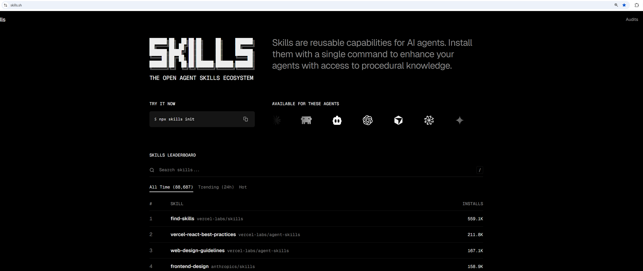
Agent Skills
npx skills add https://github.com/laguagu/claude-code-nextjs-skills --skill openai-agents-sdk
© All rights reserved for Dr. Ryan Ahmed @Stemplicity Inc.

Slide 34
BUILD MULTI AI AGENTS WORKFLOWS

Slide 35





Build Multi AI Agents Workflows
In this project, we will build a team of AI agents that work together to achieve a goal.
Analyst AI Agent
Writer AI Agent
Researcher AI Agent
Analysis & Key Insights
Research Findings
Topic
© All rights reserved for Dr. Ryan Ahmed @Stemplicity Inc.
Manager Function

Slide 36
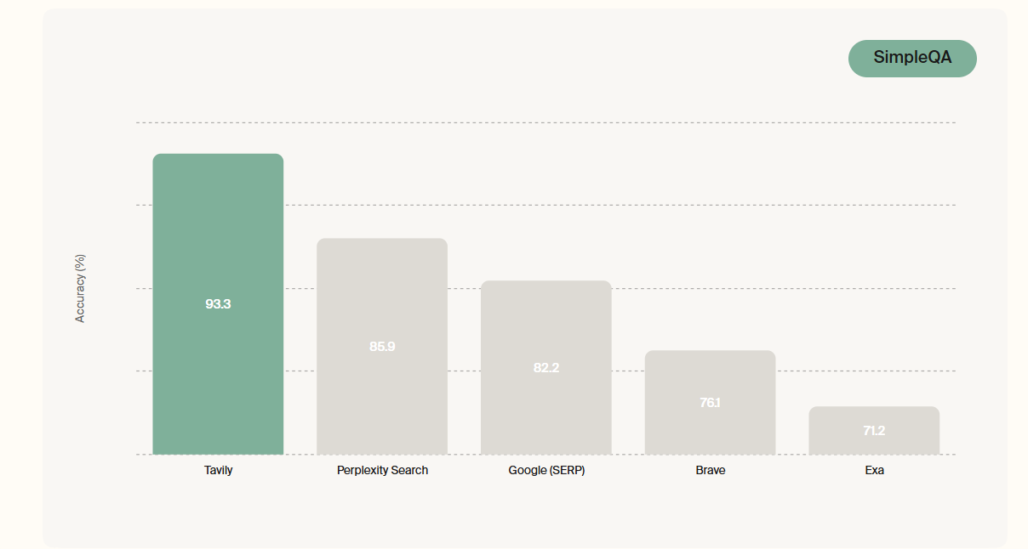
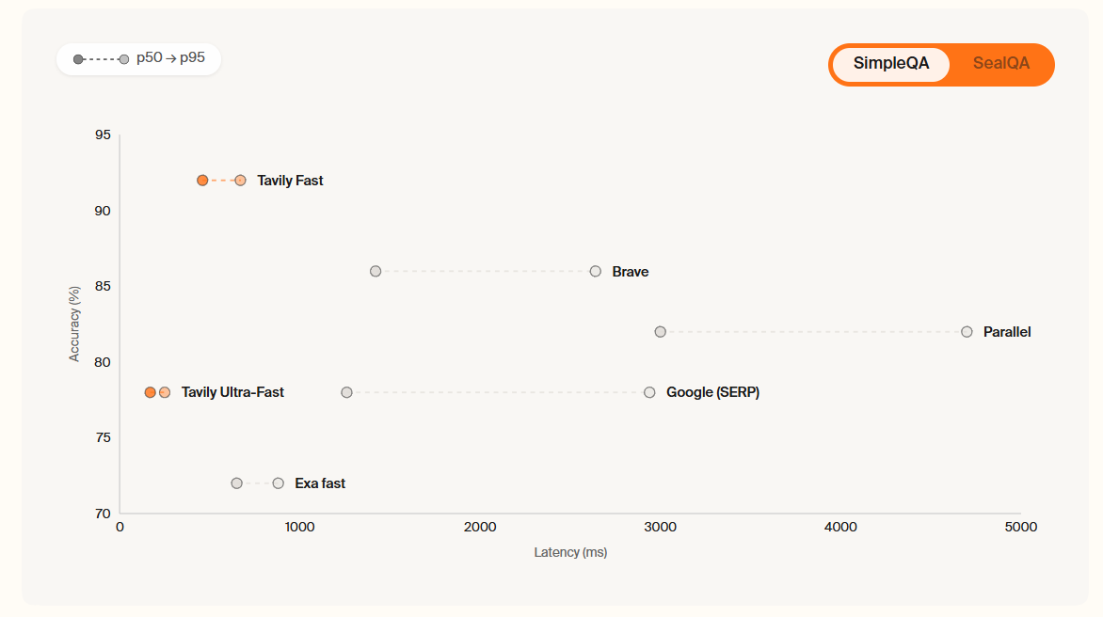
Tavily API
Tavily allows developers to connect AI agents to the web.
It’s used for Real-time search, extraction, research, and web crawling through a single, secure API.
© All rights reserved for Dr. Ryan Ahmed @Stemplicity Inc.
Source: https://www.tavily.com/

Slide 37
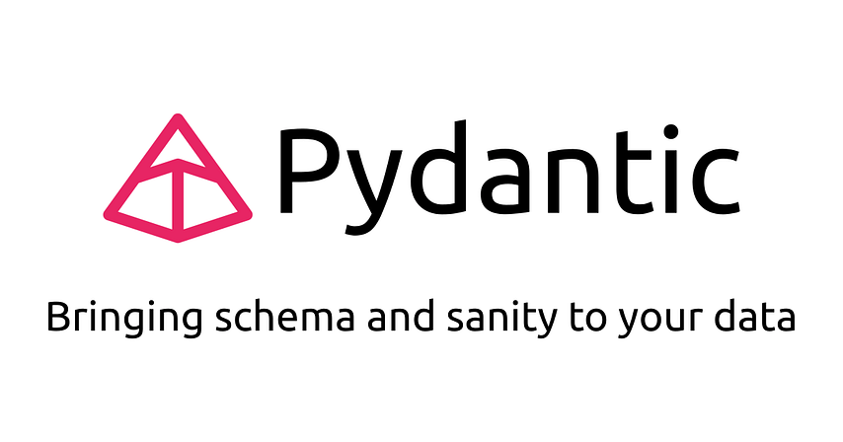
Pydantic
Pydantic is a Python library used to validate and parse data using Python type hints. It ensures that the data you get is clean, well-structured, and follows the rules you set.
How it works:
You define a data structure using a class
Pydantic ensures the data is correct (types, required fields, etc.)
It even converts data automatically if possible (e.g., turns strings into numbers or dates)
© All rights reserved for Dr. Ryan Ahmed @Stemplicity Inc.

Slide 38
Key Learning Outcomes
Create modular AI agents (Researcher, Analyst, Writer) with specialized roles for information gathering, analysis, and reporting.
Implement agent collaboration by passing outputs from one agent to another in a structured workflow.
Customize AI agent behavior by rewriting instructions to adapt outputs to specific languages or formats (e.g., French report generation).
Build a manager function to orchestrate multi-agent workflows from input to final deliverable.
© All rights reserved for Dr. Ryan Ahmed @Stemplicity Inc.

Slide 39
Project 2: Build Multi-agent Workflows
Access Jupyter Notebook on Google Colab here:
https://drive.google.com/file/d/1IoUuiCqcYk4A69Emc4P1TfHLc3don8pj/view?usp=sharing
© All rights reserved for Dr. Ryan Ahmed @Stemplicity Inc.

Slide 40
BUILD MULTI-AGENT WORKFLOWS WITH CLAUDE CODE

Slide 41


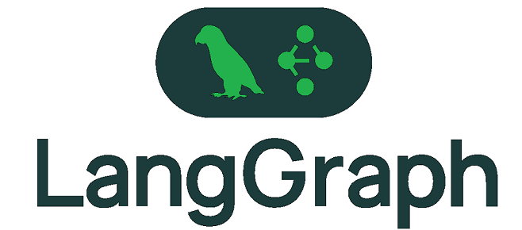

The Problem
OpenAI Agents SDK
Analyst AI Agent
Writer AI Agent
Researcher AI Agent
Analysis & Key Insights
Research Findings
Topic
© All rights reserved for Dr. Ryan Ahmed @Stemplicity Inc.
Manager Function

Slide 42
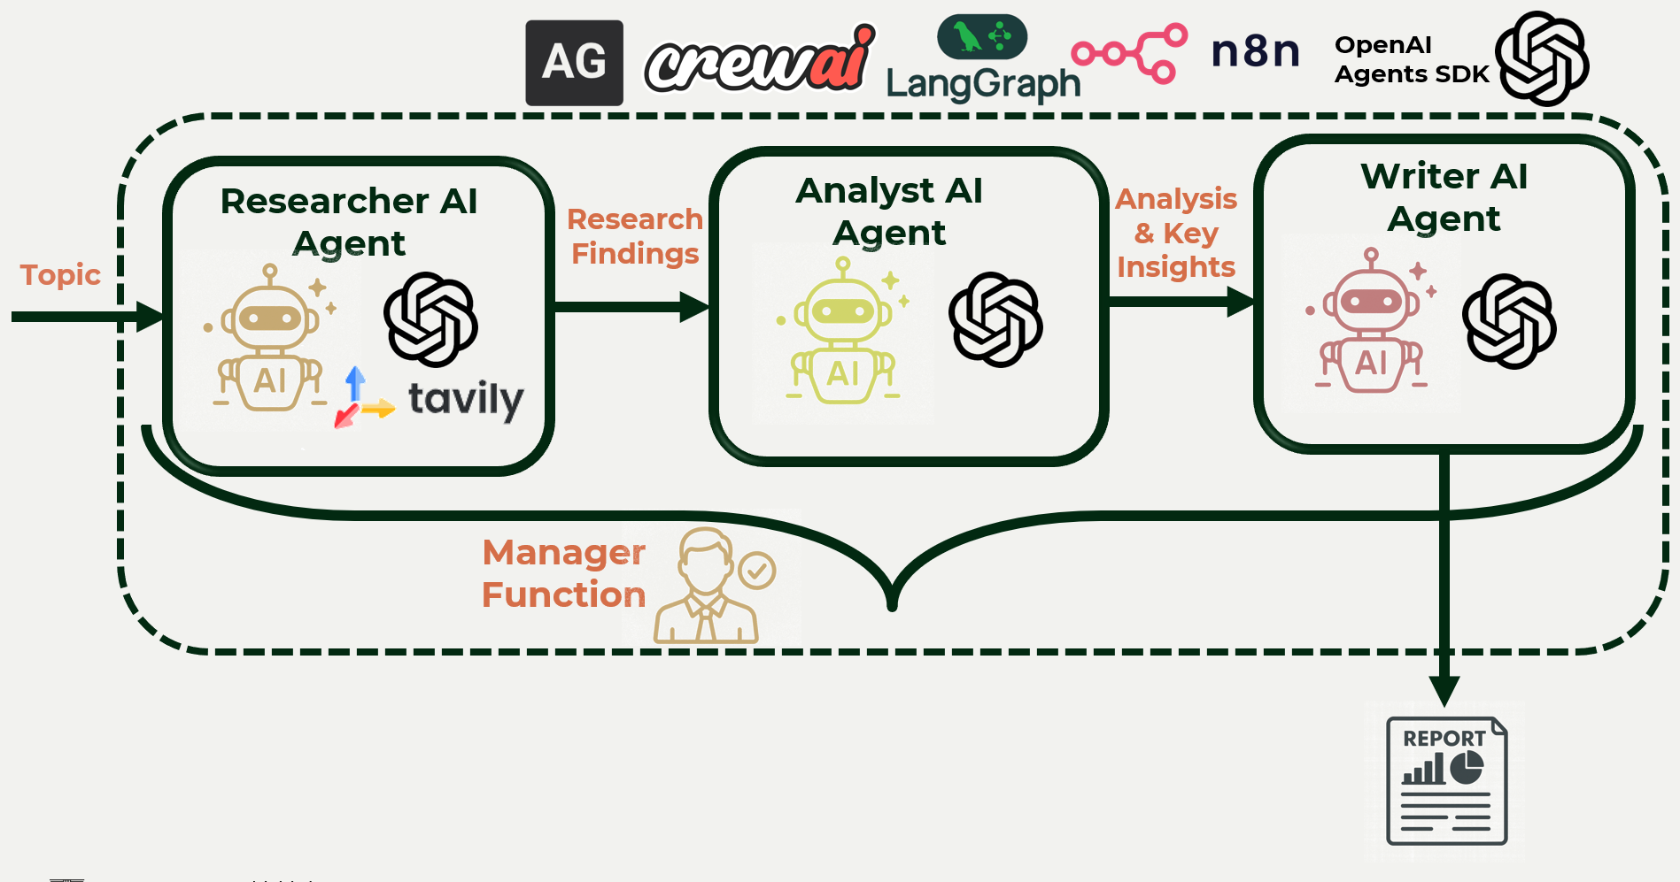


The Problem
Skills
Instructions
Implement workflow
Workflow Generated!

Slide 43
What You’ll Build
© All rights reserved for Dr. Ryan Ahmed @Stemplicity Inc.

Slide 44
Thank you!

